Slide 1
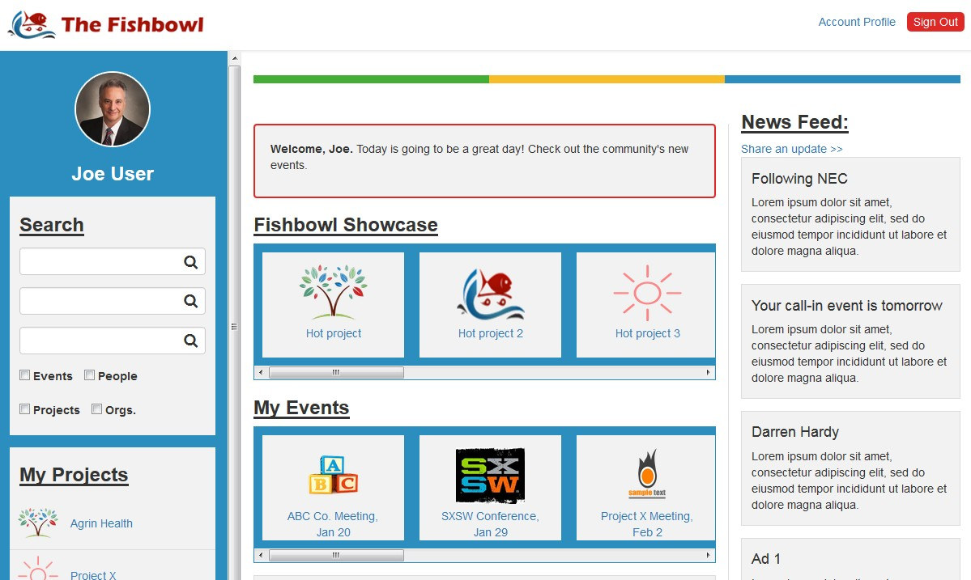

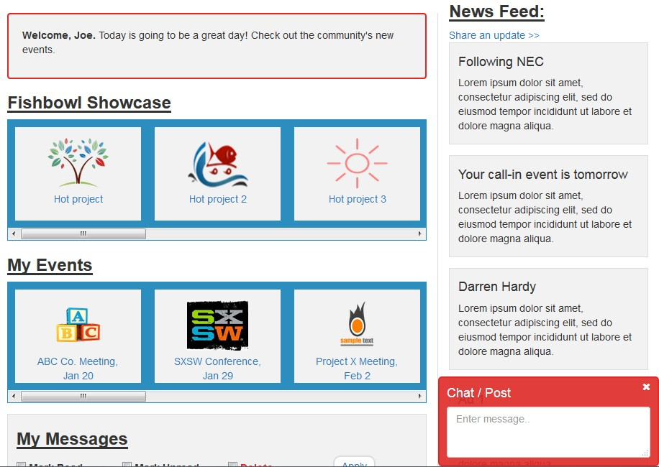

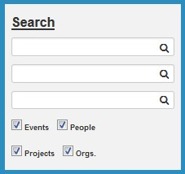
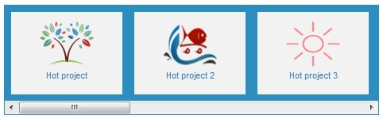


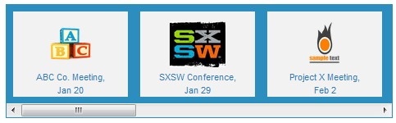
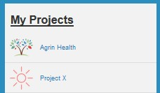
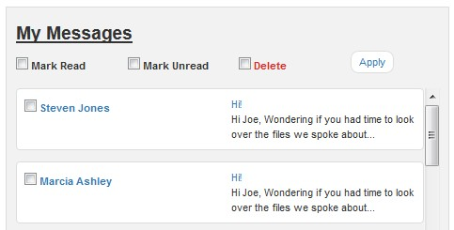

Dashboard
Community News
Share
2/10/16
My Favorites
Name
Location
Key Word
2/10/16
Go Fish
Create
2/10/16
Create
Feb 10, 2016
My Resources
Find
Fishbowl – How To…
Feb 10, 2016
Fishbowl – Fun Quiz…
Terms of Use Privacy Policy
© 2016 Fishbowl, LLC
Contact Us Feedback
Notes:
Member Dashboard
Click on User image/name to return to Dashboard from any screen
Showcase and Events can collapse to just the Title
“Create” will open a dialogue box that allows User to compose and send message
Clicking on a message will expand it to reveal the entire message as well as reply and delete options
Chat can be minimized (vs. closed)
Reporting will be done through My Resources
“Share” will open a dialogue box that will allow User to create a post to the Community News

Slide 2

Dashboard
Community News
Share
2/10/16
New Message
My Favorites
Name
To:
Location
Title:
Key Word
2/10/16
Message:
Go Fish
Create
2/10/16
Create
Feb 10, 2016
My Resources
Find
Send
Fishbowl – How To…
Feb 10, 2016
Fishbowl – Fun Quiz…
Terms of Use Privacy Policy
© 2016 Fishbowl, LLC
Contact Us Feedback
Notes:
Create Message
- If a Project is selected as the “To” in the message, it will go to the Project Owner

Slide 3

Dashboard
Community News
Share
2/10/16
My Favorites
Share something with the Community
Date and website are required for Events
Name
Location
Event
Post
Key Word
Date
Website for more information
Upload image
2/10/16
Go Fish
Title
Comments
Create
2/10/16
Create
I am authorized to share this information and any uploaded images.
Feb 10, 2016
Cancel
Share
My Resources
Find
Fishbowl – How To…
Feb 10, 2016
Fishbowl – Fun Quiz…
Terms of Use Privacy Policy
© 2016 Fishbowl, LLC
Contact Us Feedback
Notes:
Community News post
Share button is only available once the authorization attestation box is checked
Cancel and Share both return User to Dashboard
Share enters information into Community News queue

Slide 4
Dashboard
Member Profile
Customer ID
Information in the red boxes is required to Save Changes.
First Name
Last Name
email
Password
My Favorites
Phone
Address
City
State
Zip code
Name
Title
LinkedIn
Twitter
Other website
Location
Key Word
Headline
Go Fish
Bio
Create
Skills (enter at least 1)
Company
Role/ Title
Start Date
End Date
Add Experience
My Resources
Find
Preview
I attest that this information is true and accurate.
Save Changes
Fishbowl – How To…
Fishbowl – Fun Quiz…
Account Status and Billing
Terms of Use Privacy Policy
© 2016 Fishbowl, LLC
Contact Us Feedback
Notes:
Individual Account Profile – Member Profile
Black box is READ ONLY. Red boxes are required.
Password shall show 1st and last character. The rest will be *

Slide 5
Dashboard
Account Status and Billing
Information in the red boxes is required to Save Changes.
Member
Account Type
Account Status
Balance
As of
Renews on
Auto-renewal
$
ON
My Favorites
Name
Card on File
Add or Update Card
Last 4 digits
Exp. Date
Location
Name on Card
Card Number
Key Word
Exp. Date
CVV
Save Changes
Go Fish
Purchase History
Check all
Print History
Create
Item Description $Amount Paid Date
Cancel Membership
My Resources
Find
Fishbowl – How To…
Fishbowl – Fun Quiz…
Terms of Use Privacy Policy
© 2016 Fishbowl, LLC
Contact Us Feedback
Notes:
Individual Account Profile (cont.) – Account Status and Billing
Black boxes are READ ONLY
Auto-renewal is toggle
Only make new Card fields available if box is checked, then all are required
Print History prints the Purchase history (Item description, amount paid and date) for all of the Items checked
Cancel membership should trigger warning – “Are you sure? If you are the Owner of a Project, Canceling your membership will close the project.” and prompt User to answer Yes or No. No returns them to this page. Yes returns message “We are sorry to see you go. We will hold your profile data for 60 days in case you decide to return.” When they close that dialogue box, they are automatically logged out and the system immediately changes the account status to Inactive which disables their login.

Slide 6
Member Profile
Customer ID
Information in the red boxes is required to Save Changes.
Company ABC
Company Name
Date Founded
Password · · · · ·
My Favorites
DBA
Company website
Name
Industry/ Industries
Location
Minority Owned
Non-Profit
Key Word
Stage
Annual Revenue
# Employees
Y / N
Y / N
Go Fish
Business Address
Non-Profit ID#
Main
Address
City
State
Zip code
Add location
Main Company Contact - Fishbowl Account Administrator
Create
First Name
Last Name
Title
email
Phone
Address
City
State
Zip code
Add Contact
Company Overview
My Resources
Find
Fishbowl – How To…
Company Products and Services (enter at least 1)
Fishbowl – Fun Quiz…
Preview
I attest that this information is true and accurate.
Save Changes
Terms of Use Privacy Policy
© 2016 Fishbowl, LLC
Contact Us Feedback
Notes:
Organization Account Profile – Member Profile
Black box is READ ONLY. Red boxes are required.
Password shall show 1st and last character. The rest will be *

Slide 7
Dashboard
Account Status and Billing
Information in the red boxes is required to Save Changes.
Company ABC
Member
Account Type
Account Status
Balance
As of
Renews on
Auto-renewal
$
ON
My Favorites
Name
Card on File
Add or Update Card
Last 4 digits
Exp. Date
Location
Name on Card
Card Number
Key Word
Exp. Date
CVV
Save Changes
Go Fish
Purchase History
Check all
Print History
Item Description $Amount Paid Date
Create
Cancel Membership
Advertising Management
You have
#
advertisements available on your account.
Purchase
More
My Resources
Find
Current Advertisements
Delete
Create New
Post
Fishbowl – How To…
Content currently displayed
Content to be displayed
Fishbowl – Fun Quiz…
Terms of Use Privacy Policy
© 2016 Fishbowl, LLC
Contact Us Feedback
Notes:
Organization Account Profile (cont.) – Account Status and Billing
Black boxes are READ ONLY
Auto-renewal is toggle
Only make new Card fields available if box is checked, then all are required
Print History prints the Purchase history (Item description, amount paid and date) for all of the Items checked
Cancel membership should prompt warning – “Are you sure? If you are the Owner of a Project, Canceling your membership will close the project.” and prompt User to answer Yes or No. No returns them to this page. Yes returns message “We are sorry to see you go. We will hold your profile data for 60 days in case you decide to return.” When they close that dialogue box, they are automatically logged out and the system immediately changes the account status to Inactive which disables their login, and deletes all advertisements associated with that Account.
“Purchase More” opens dialogue box that allows User to select how many advertisements and enter a Coupon Code (if they have one), it calculates the amount due and User accepts or cancels the transaction.
If zero advertisements are available, User can still create new, but when they click “Post”, they get a warning that reads “You currently have 0 advertisements on your account. Posting this advertisement will charge your account $150. Do you want to continue?” No returns them to this page. Yes creates Advertisement and refreshes this page with new advertisement in the Current Advertisements list.

Slide 8


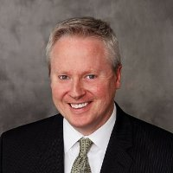
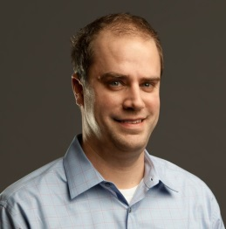
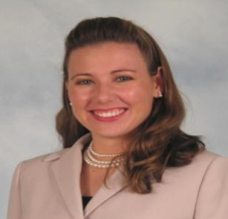

Dashboard
Search Results
Clear
Events
My Favorites
Name
Location
Key Word
People
Go Fish
Create
Tim Rogers
Nashville, TN
Adam Solesby
Nashville, TN
Karen Thomas
Nashville, TN
Projects
My Resources
Find
Fishbowl – How To…
Fishbowl – Fun Quiz…
Organizations
Terms of Use Privacy Policy
© 2016 Fishbowl, LLC
Contact Us Feedback
Notes:
Search Results
Criteria used should show in left-hand navigation until “Clear” button is selected
My Favorites button executes a search for all People, projects and organizations previously tagged as Favorite/ Following by the User
Click on events opens new browser tab to event website
Click on People, projects or organizations takes User to the profile page

Slide 9

Dashboard
Return to Search
Karen Thomas
Founder and CEO
Looking for a healthcare start-up Co-founder
Nashville, TN
My Favorites
Karen Thomas has 20 years’ healthcare experience, including roles in the clinical, payer, provider and technology vendor segments where she successfully managed executive/ C-suite relationships, used process redesign to improve margins, integrated mission-critical acquisitions, and directed strategic growth of multi-million dollar business units.
Name
Location
Key Word
Follow
https://www.linkedin.com/in/kthomashealthcare
Send Message
Go Fish
Skills and Experience
Projects
Create
Healthcare management, Strategic Planning, LEAN, Six Sigma, project management, program management
The Fishbowl
An online community designed to help Entrepreneurs find the resources they need to start and…
2 Members www.MyFishbowl.net
Co-founder, Fishbowl 9/1/15 – present
CEO, Agrin Health 3/1/14 - present
Consultant, K Thomas
Consulting 4/1/13 - present
My Resources
Find
Fishbowl – How To…
Fishbowl – Fun Quiz…
Terms of Use Privacy Policy
© 2016 Fishbowl, LLC
Contact Us Feedback
Notes:
Individual Member Profile View (from Search Results)
Member Name, Title
Headline, City, State
Bio
LinkedIn/ Twitter / website
Skills and Experience
Associated Projects
Follow/Following is toggle. Following flags for “My Favorites” search and News Feed.
Clicking on Project area directs User to Project’s profile page

Slide 10

Dashboard
Return to Search
Karen Thomas Consulting
Founded 2013
Healthcare, Consulting
Nashville, TN
My Favorites
We have a simple mission: to help companies grow and thrive amidst the healthcare industry tumult. Whether it's simply helping a Client think through their next step, covering a mission-critical operations gap, or building an infrastructure that will allow them to withstand the challenges of rapid growth and change, we are dedicated to the long-term success of our Clients.
Name
Location
Key Word
Following
www.KThomasHealthcare.com
Send Message
Go Fish
Products and Services
Projects
Create
Growth Strategy, Operations Evaluation and Redesign, Process Improvement, Acquisition evaluation and integration, Competitive Analysis, Industry Analysis and Forecasting.
The Fishbowl
An online community designed to help Entrepreneurs find the resources they need to start and…
2 Members www.MyFishbowl.net
My Resources
Find
Fishbowl – How To…
Fishbowl – Fun Quiz…
Terms of Use Privacy Policy
© 2016 Fishbowl, LLC
Contact Us Feedback
Notes:
Organizational Member Profile View (from Search Results)
Member Name, Date Founded
Industries, City, State
Overview
website
Products and Services
Associated Projects
Follow/Following is toggle. Following flags for “My Favorites” search and News Feed.
Clicking on Project area directs User to Project’s profile page

Slide 11


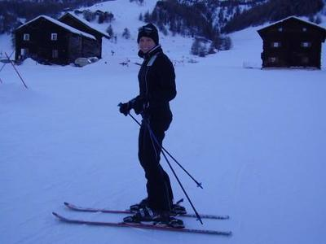
Dashboard
Return to Search
Agrin Health Project
Created Feb 2, 2016
Healthcare, Healthcare IT
Nashville, TN
My Favorites
A personal health and wellness platform with individualized services to achieve your health and wellness goals.
Name
Location
Key Word
Following
www.Agrin Health.com
Request to Join
Go Fish
Description
Members (2)
The traditional fragmented and impersonal approaches to patient engagement have failed to improve healthcare outcomes and reduce cost. Healthcare must find an effective way to engage consumers and get them to develop and sustain healthier behaviors.
Healthcare Providers and Consumers want the same thing… a simple, effective solution that engages individuals
in their healthcare.
Owner
Karen Thomas
Karen Thomas has 20 years’ healthcare experience, including roles in the clinical, payer, provider and technology vendor…
Create
Member
Kimberly Frederickson
As founding partner and Chief Executive Officer, Ms. Fredrickson handles all aspects of Business Management and…
My Resources
Find
Fishbowl – How To…
Fishbowl – Fun Quiz…
Terms of Use Privacy Policy
© 2016 Fishbowl, LLC
Contact Us Feedback
Notes:
Project Profile View (from Search Results)
Project Name (Name+Project), Date Created
Industries, City, State
Overview
website
Description
Associated Members
Follow/Following is toggle. Following flags for “My Favorites” search and News Feed.
Clicking on “Request to Join” sends Project owner a system message asking if they want to accept User into the project. Project Owner can accept or reject request within message, and system reply to requesting User is generated indicating whether their request was granted or declined.
Clicking on Member area directs User to Member’s profile page.
Clicking on message icon directs User to Message Creation in Dashboard with Project Owner pre-populated in “To” box

Slide 12
Dashboard
My Projects
The Fishbowl
An online community designed to help Entrepreneurs find the resources they need to start and grow a business successfully.
www.MyFishbowl.net
Project Owner
My Favorites
Name
2 Members
Location
Agrin Health
A personal health and wellness platform with individualized services to achieve your health and wellness goals.
www.AgrinHealth.com
Project Member
Key Word
Go Fish
5 Members
Create
Create a Project
You have
#
projects available on your account.
Purchase More
Title
website
Upload image
Overview/ Purpose
My Resources
Find
Description / Details
Fishbowl – How To…
City
State
Make private
(will not show up in search)
Create
Fishbowl – Fun Quiz…
Terms of Use Privacy Policy
© 2016 Fishbowl, LLC
Contact Us Feedback
Notes:
My Projects
Users click on My Projects or “Create” from the left-hand navigation to open this view
Display project logo and # of members
Post title, overview and website in middle
Project role on right
“Purchase More” opens dialogue box that allows User to select how many projects and enter a Coupon Code (if they have one), it calculates the amount due and User accepts or cancels the transaction.
Create a Project box (white area) is hidden until User clicks on “Create a Project”
If zero projects are available on the User’s account, User can still create new, but when they click “Create”, they get a warning that reads “You currently have 0 projects on your account. Creating this project will charge your account $10. Do you want to continue?” No returns them to this page. Yes creates the project and directs them to the new Project profile page.

Slide 13

Dashboard
edit
Project Chat
Agrin Health Project
Feb 10, 2016
Created Feb 2, 2016
Nashville, TN
Karen Thomas
Share
Healthcare, Healthcare IT
# Followers
www.Agrin Health.com
My Favorites
Name
Overview:
A personal health and wellness platform with individualized services to achieve your health and wellness goals.
Location
Kimberly Frederickson
Key Word
Description:
Share
Go Fish
The traditional fragmented and impersonal approaches to patient engagement have failed to improve healthcare outcomes and reduce cost. Healthcare must find an effective way to engage consumers and get them to develop and sustain healthier behaviors.
Healthcare Providers and Consumers want the same thing…
a simple, effective solution that engages individuals
in their healthcare.
Create
Karen Thomas
Share
Members (2):
Invite
My Resources
Find
Fishbowl – How To…
Karen Thomas
Kimberly Frederickson
Fishbowl – Fun Quiz…
Owner
Member
Terms of Use Privacy Policy
© 2016 Fishbowl, LLC
Contact Us Feedback
Notes:
Project Dashboard
Edit is only visible to Project Owner(s). All project profile fields are editable EXCEPT date created (i.e. image, name, city, state, industries, website, overview and description).
Red plus is only visible to Owner. Clicking on it will launch a warning “Are you sure you want to remove this member?” No returns them to this page. Yes updates the project affiliations and refreshes the page to show the member is no longer affiliated with the project.
Invite button opens a search box that allows a Project member to find a Fishbowl member and trigger a system message inviting them to join the project. The invited Member can accept or reject that message and the response is posted in the Project chat.
“Share” in project chat will copy that single chat post to the Community News as posted by the Project
Chat can be minimized (vs. closed)

Slide 14

Dashboard
My Resources
How to use The Fishbowl
This is a User guide for The Fishbowl intended for all Users. Check out the Tips and Tricks section to get the most out of your Membership.
2/02/2016
My Favorites
Name
Location
The Fishbowl
Key Word
Entrepreneur Personality Quiz
Take this free, fun quiz to find out what kind of Entrepreneur personality you are. Use your results to get a free avatar for your Fishbowl profile.
2/07/2016
Go Fish
The Fishbowl
Create
Recommended Resources
Start-up guru Steve Blank has published a variety of free tools on his website, including the Business Model Canvas and Lean Launchpad videos.
http://steveblank.com/tools-and-blogs-for-entrepreneurs/
2/10/2016
My Resources
Find
The Fishbowl
Fishbowl – How To…
Fishbowl – Fun Quiz…
Terms of Use Privacy Policy
© 2016 Fishbowl, LLC
Contact Us Feedback
Notes:
My Resources
Users click on “Find” from the left-hand navigation to open this view
Display logo and name of posting User on left (will only be The Fishbowl to start)
Post title and description in middle
Date posted and any attachment on right

Slide 15
ADMIN User
Support & Account Management
Message Management
Resource Management
Showcase Management
Reporting
Terms of Use Privacy Policy
© 2016 Fishbowl, LLC
Contact Us Feedback
Notes:
Admin page – Support & Account Management
Pull up Customer
Reset password
Create Technical Support ticket
Check Account status, next renewal date, balance and valid credit card on file
Apply refund/credit to account

